Slide 1
Redux
state management library

Slide 2
Redux
As we learned earlier, React only supports component level state management.
In a big and complex application, large number of components are used.
React recommends to move the state to the top level component and pass the state to the nested component using properties.
It helps to some extent but it becomes complex when the components increases.

Slide 3
Redux
Redux is a JavaScript library for managing the state of applications.
It provides a way to centralize the state of an application in a single store, making it easier to debug, test and reason about the state changes in the application.
One particularly cool feature of Redux is its support for time travel.
With Redux Devtools, developers can inspect the state of their application at any point in time, including past and future states.
This makes it easier to debug and understand the state changes in the application.

Slide 4
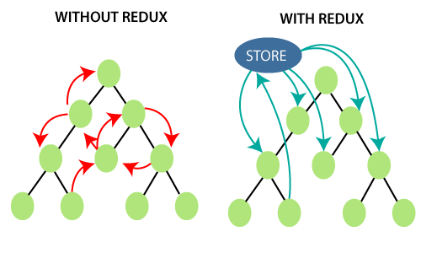

Slide 5
Redux
Store − The central place to store the state of the application.
Actions − Action is a plain object with the type of the action to be done and the input (called payload) necessary to do the action.
Reducers − Reducers are pure functions used to create a new state based on the existing state and the current action. It returns the newly created state.

Slide 6
Redux
Action creators − Action creator creates an action with proper action type and data necessary for the action and returns the action.
Component − Component can connect to the store to get the current state and dispatch action to the store so that the store executes the action and updates it's current state.

Slide 7
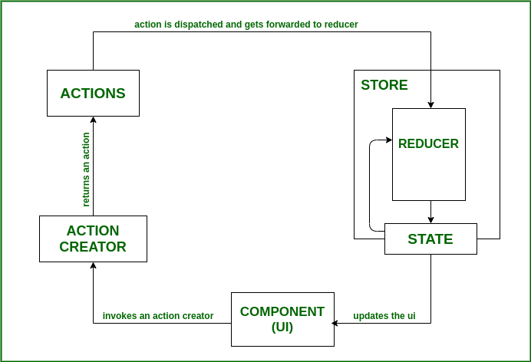

Slide 9
Redux
Install Redux Toolkit and React Redux
npm install @reduxjs/toolkit react-redux

Slide 10
Redux
Create a Redux store with configureStore
configureStore accepts a reducer function as a named argument
configureStore automatically sets up the store with good default settings
Provide the Redux store to the React application components
Put a React Redux <Provider> component around your <App />
Pass the Redux store as <Provider store={store}>

Slide 11
Redux
Use the React Redux useSelector/useDispatch hooks in React components
Read data from the store with the useSelector hook
Get the dispatch function with the useDispatch hook, and dispatch actions as needed

Slide 12
Redux
//Create a Redux Store
import { configureStore } from "@reduxjs/toolkit";
import CounterReducer from "./CounterReducer";
export const Store = configureStore({
reducer: CounterReducer
})

Slide 13
Redux
//Provide the Redux Store to React
function App() {
return (
<Provider store={Store}>
<div className="App">
<Counter />
</div>
</Provider>
);
}
export default App;

Slide 14
Redux
//Provide the Redux Action to React
export const INCREMENT = 'INCREMENT'
export const DECREMENT = 'DECREMENT'
export const increment = () => ({
type: INCREMENT
})
export const decrement = () => ({
type: DECREMENT
})

Slide 15
Redux
//Provide the Redux Action to React
import { DECREMENT, INCREMENT } from "./CounterAction";
const initialState = {
count: 0
}

Slide 16
Redux
const CounterReducer = (state = initialState, action) => {
switch (action.type) {
case INCREMENT:
return { count: state.count + 1 }
case DECREMENT:
return { count: state.count - 1 }
default:
return state;
}
}
export default CounterReducer;

Slide 17
Redux
import React from 'react'
import { decrement, increment } from '../redux/CounterAction';
import { useDispatch, useSelector } from 'react-redux';
const Counter = () => {
const dispatch = useDispatch();
const count = useSelector((state) => state.count);
return (

Slide 18
Redux
<div>
<p>Count: {count}</p>
<button onClick={() => dispatch(decrement())}>Decrement</button>
<button onClick={() => dispatch(increment())}>Increment</button>
</div>
)
}
export default Counter;

Slide 19
Redux Thunk
state management library

Slide 20
Redux Thunk
Redux Thunk is a middleware for Redux that allows you to write action creators that return functions instead of plain action objects.
This is particularly useful for handling asynchronous operations, such as making API calls or dispatching multiple actions over time.
By using Redux Thunk, you can delay the dispatch of an action, perform asynchronous operations, and then dispatch the actual action with the received data.
This enables you to handle complex asynchronous logic in a Redux application.

Slide 21
Redux Thunk
npm install redux thunk

Slide 22
Redux
// Standard action creator
const fetchDataRequest = () => ({
type: 'FETCH_DATA_REQUEST',
});
// Thunk action creator
const fetchData = () => {
return (dispatch) => {
dispatch(fetchDataRequest());

Slide 23
Redux
// Perform asynchronous operation (e.g., API call)
api.fetchData()
.then((data) => {
dispatch({ type: 'FETCH_DATA_SUCCESS', payload: data });
})
.catch((error) => {
dispatch({ type: 'FETCH_DATA_FAILURE', payload: error });
});
};
};

